Slide 1
Machine Learning CSE - 403 Lecture - 06

Slide 2
Supervised Learning
Regression
Regression algorithms are used if there is a relationship between the input variable and the output variable. It is used for the prediction of continuous variables, such as Weather forecasting, Market Trends, etc.
Classification
Classification algorithms are used when the output variable is categorical, which means there are two classes such as Yes-No, Male-Female, True-false, etc.

Slide 3
Regression analysis
Regression analysis is a statistical method to model the relationship between a dependent (target) and independent (predictor) variables with one or more independent variables.
More specifically, Regression analysis helps us to understand how the value of the dependent variable is changing corresponding to an independent variable when other independent variables are held fixed.
It predicts continuous/real values such as temperature, age, salary, price, etc.

Slide 4
Regression analysis
In Regression, we plot a graph between the variables which best fits the given data points, using this plot, the machine learning model can make predictions about the data.
In simple words, "Regression shows a line or curve that passes through all the data points on target-predictor graph in such a way that the vertical distance between the data points and the regression line is minimum."
Some examples of regression can be as:
Prediction of rain using temperature and other factors
Determining Market trends
Prediction of road accidents due to rash driving.

Slide 5
Types of Regression
Linear Regression
Logistic Regression
Polynomial Regression
Ridge Regression
Lasso Regression:

Slide 6
Terminologies Related to the Regression Analysis:
Dependent Variable: The main factor in Regression analysis which we want to predict or understand is called the dependent variable. It is also called target variable.
Independent Variable: The factors which affect the dependent variables or which are used to predict the values of the dependent variables are called independent variable, also called as a predictor.

Slide 7
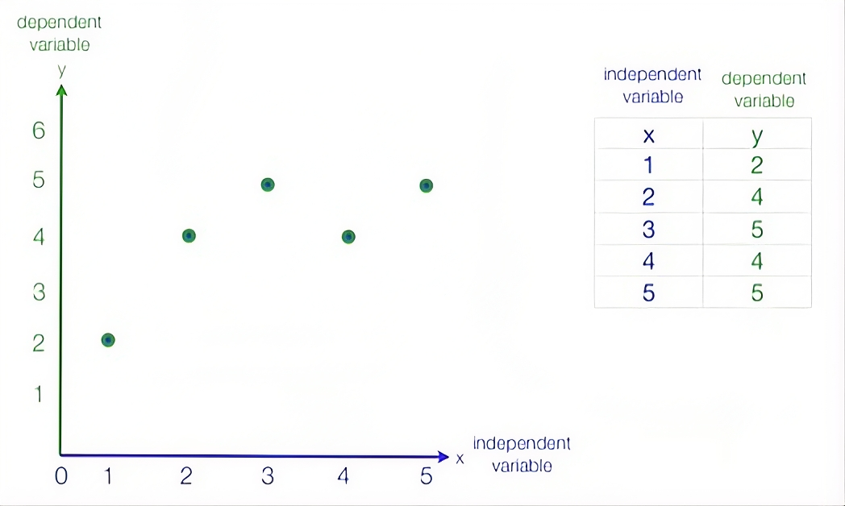
Terminologies Related to the Regression Analysis:

Slide 8
Terminologies Related to the Regression Analysis:
Outliers: Outlier is an observation which contains either very low value or very high value in comparison to other observed values. An outlier may hamper the result, so it should be avoided.
Underfitting and Overfitting: If our algorithm works well with the training dataset but not well with test dataset, then such problem is called Overfitting. And if our algorithm does not perform well even with training dataset, then such problem is called underfitting.

Slide 9
Regression Model
A regression model is a statistical model for estimating the relationships between a dependent variable and one or more independent (explanatory) variables
Dependent Variable: This is the main factor that we’re trying to understand or predict. Also called outcome variable
Independent Variables: These are the factors that we hypothesize have an impact on our dependent variable. Also known as predictors, covariates or features

Slide 10
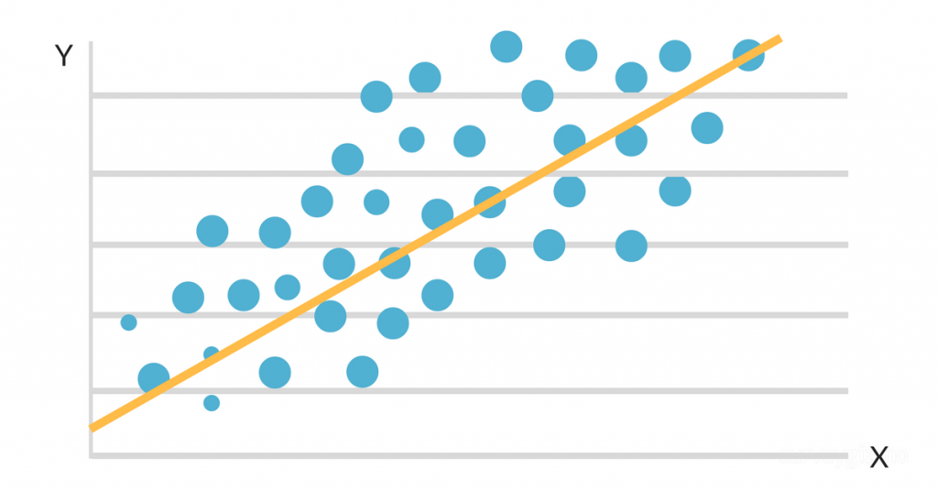
Example: Regression Model
The regression line represents the relationship between independent and dependent variable.
The formula for a regression line might look something like Y = 100 + 7X + error term.

Slide 11
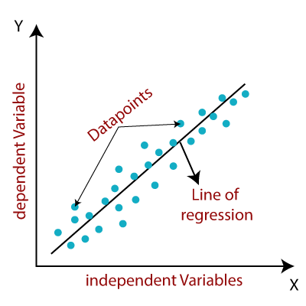
Linear Regression (1/3)
Linear regression algorithm shows a linear relationship between a dependent (y) and one or more independent (X) variables, hence called as linear regression.
Since linear regression shows the linear relationship, which means it finds how the value of the dependent variable is changing according to the value of the independent variable.
The linear regression model provides a sloped straight line representing the relationship between the variables

Slide 12
Linear Regression (2/3)
Mathematically, we can represent a linear regression as:
y= a₀+a₁x+ ε
Here,
Y= Dependent Variable (Target Variable)
X= Independent Variable (predictor Variable)
a0= intercept of the line (Gives an additional degree of freedom)
a1 = Linear regression coefficient (scale factor to each input value).
ε = random error
The values for x and y variables are training datasets for Linear Regression model representation.

Slide 13
Linear Regression (3/3)
Before you attempt to perform linear regression, you need to make sure that your data can be analyzed using this procedure. Your data must pass through certain required assumptions.
Here’s how you can check for these assumptions:
The variables should be measured at a continuous level. Examples of continuous variables are time, sales, weight and test scores.
Use a scatterplot to find out quickly if there is a linear relationship between those two variables.
The observations should be independent of each other (that is, there should be no dependency).
Your data should have no significant outliers.

Slide 14
Types of Linear Regression (3/4)
Simple Linear Regression: If a single independent variable is used to predict the value of a numerical dependent variable, then such a Linear Regression algorithm is called Simple Linear Regression.
Multiple Linear regression: If more than one independent variable is used to predict the value of a numerical dependent variable, then such a Linear Regression algorithm is called Multiple Linear Regression.

Slide 15
Implementing Linear Regression (3/4)
Implementing a simple linear regression model with the help of python library.
Simple Linear Regression

Slide 16
Implementing Linear Regression

Slide 17
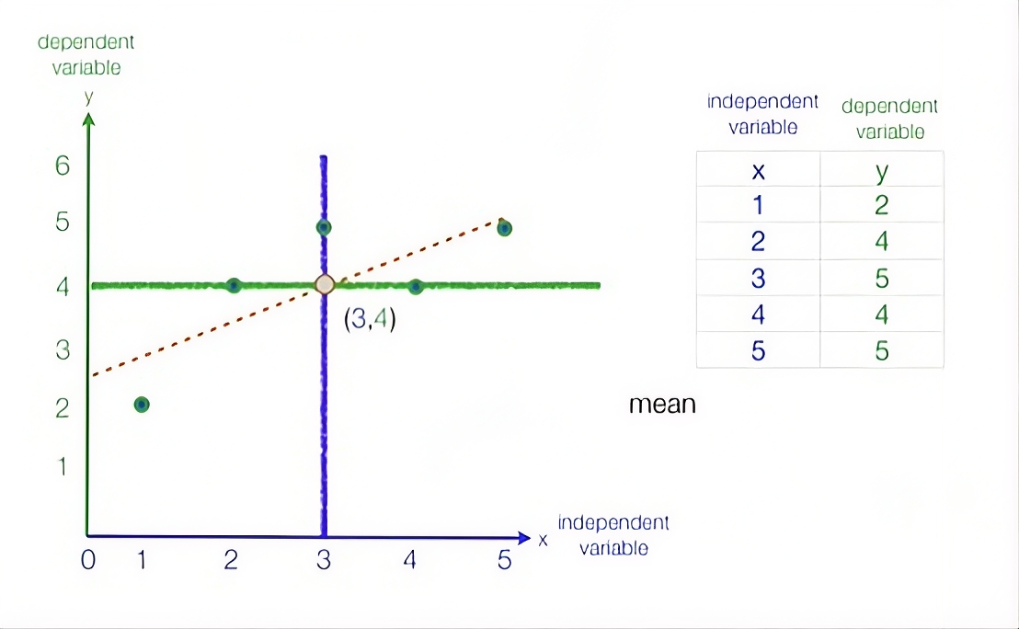
Implementing Linear Regression

Slide 18
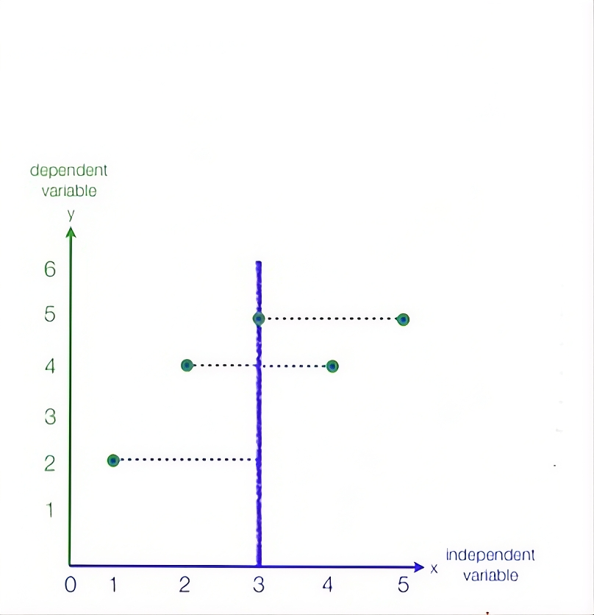
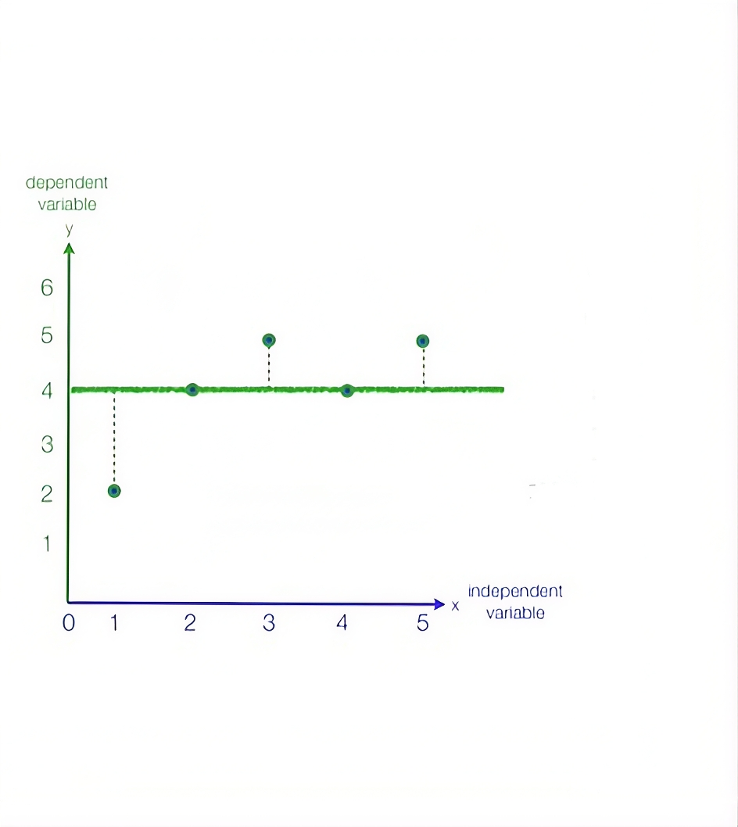
Implementing Linear Regression

Slide 19
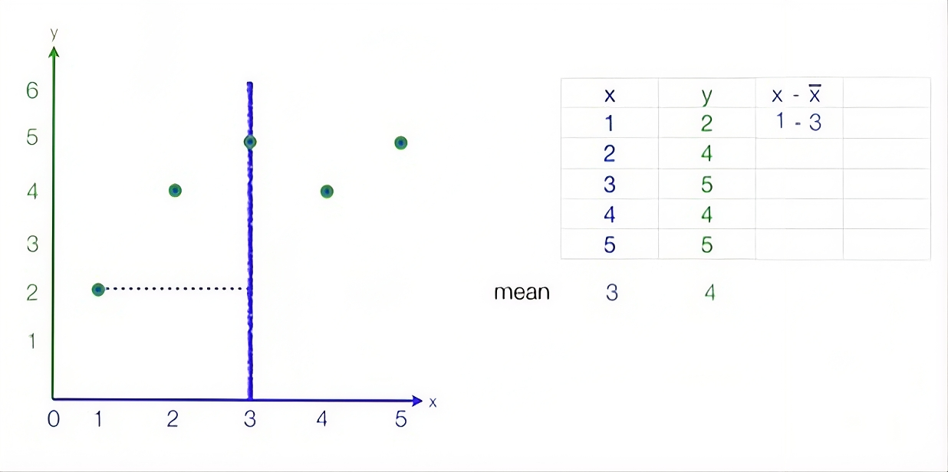
Implementing Linear Regression

Slide 20
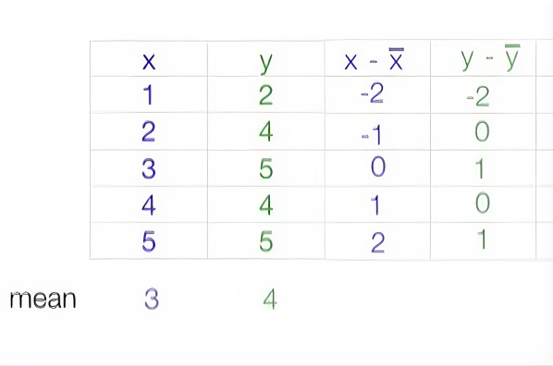
Implementing Linear Regression

Slide 21
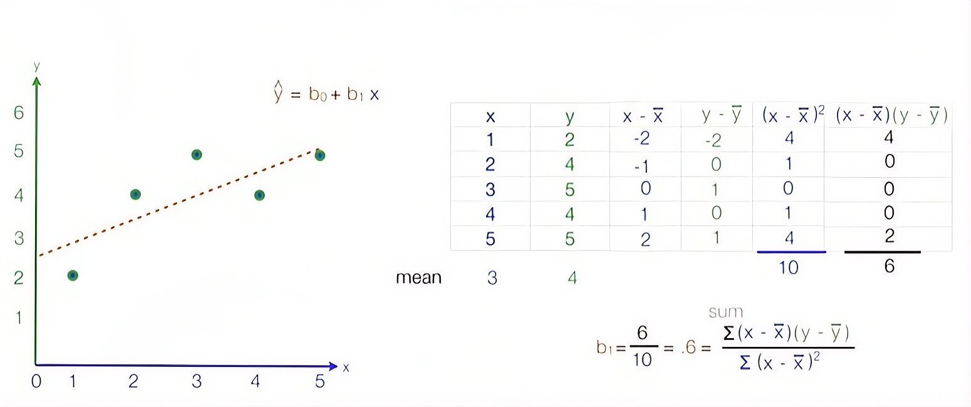
Implementing Linear Regression

Slide 22
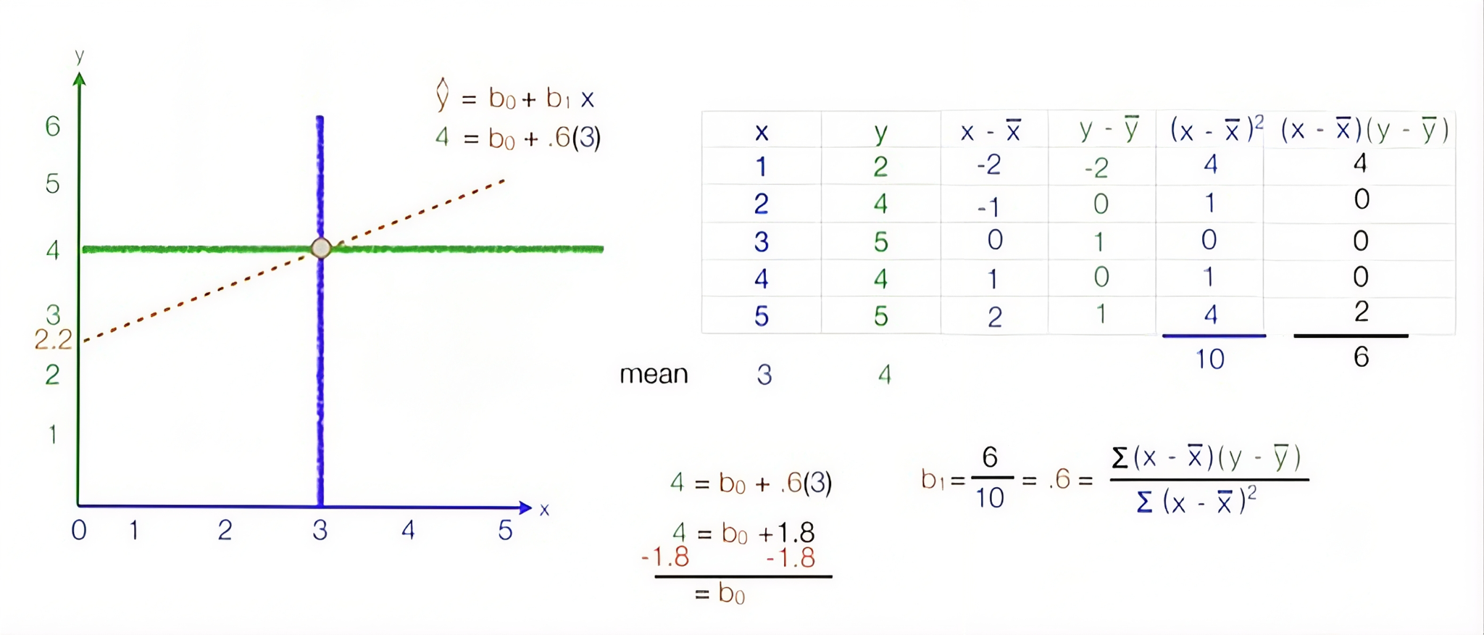
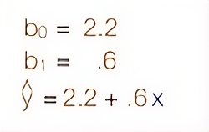
Implementing Linear Regression

Slide 23
Implementing Linear Regression
Now, Predict for X= 7, Y = ?
y= 2.2+.6(7) = 6.4

Slide 24
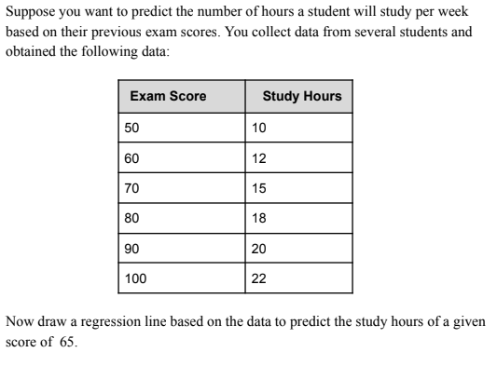
Task : Implementing Linear Regression

Slide 25



Multiple Linear Regression
Calculate b1:
Calculate b2:
Calculate a:

Slide 26
Multiple Linear Regression
Observation | X1 | X2 | Y
1 | 1 | 2 | 4
2 | 2 | 1 | 5
3 | 3 | 2 | 7
4 | 4 | 3 | 10
Apply Multiple Linear Regression on the above data and draw the regression line. Predict Y for X1 = 2, X2 = 3.

Slide 27
What is Logistic Regression
It is used for predicting the categorical dependent variable using a given set of independent variables.
Logistic regression predicts the output of a categorical dependent variable. Therefore the outcome must be a categorical or discrete value.
It can be either Yes or No, 0 or 1, true or False, etc. but instead of giving the exact value as 0 and 1, it gives the probabilistic values which lie between 0 and 1.
Linear Regression is used for solving Regression problems, whereas Logistic regression is used for solving the classification problems.

Slide 28
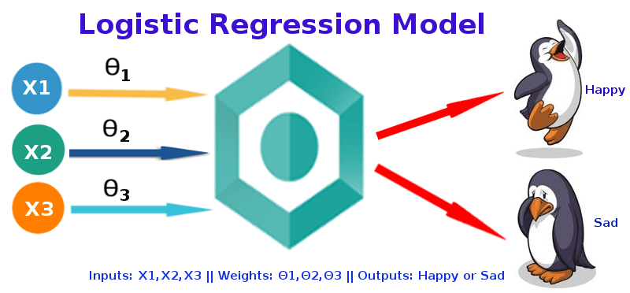
What is Logistic Regression

Slide 29
Logistic Regression
In Logistic regression, instead of fitting a regression line, we fit an "S" shaped logistic function, which predicts two maximum values (0 or 1).
The curve from the logistic function indicates the likelihood of something such as whether the cells are cancerous or not, a mouse is obese or not based on its weight, etc.
Logistic Regression is a significant machine learning algorithm because it has the ability to provide probabilities and classify new data using continuous and discrete datasets.
Logistic Regression can be used to classify the observations using different types of data and can easily determine the most effective variables used for the classification.

Slide 30
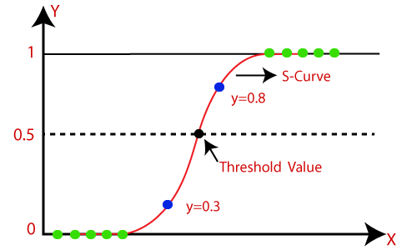
Logistic Regression

Slide 31
Types of Logistic Regression
Simple logistic regression
Logistic regression with 1 predictor variable
Multiple logistic regression
Logistic regression with multiple predictor variables
Also known as multivariable logistic regression or multivariate logistic regression

Slide 32
Linear Regression vs Logistic Regression
Linear Regression | Logistic Regression
A linear approach that models the relationship between a dependent variable and one or more independent variables. | A statistical model that predicts the probability of an outcome that can only have two values.
Used to solve regression problems | Used to solve classification problems (binary classification).
Estimates the dependent variable when there is a change in the independent variable. | Calculates the possibility of an event occurring.
Output value is continuous. | Output value is discrete.
Uses a straight line. | Uses an S curve or sigmoid function.
Example: predicting the GDP of a country, predicting product price, predicting the house selling price, score prediction. | Example: Predicting whether an email is spam or not, whether a credit card transaction is fraud or not, whether a customer will take a loan or not.

Slide 33
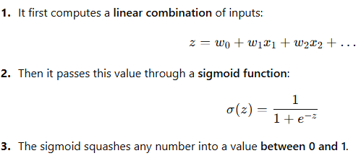
How Logistic Regression Work (Intuition)

Slide 34
Thank You

